Slide 1
Sea Shell Product
Taken from an old issue of Mathematics Teaching. I can’t currently remember which.

Slide 2
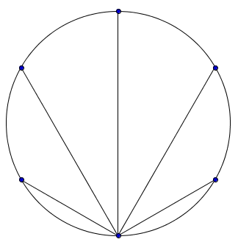
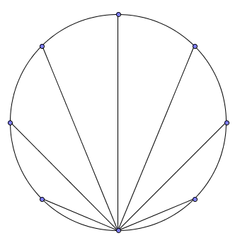
Sea Shell Product
Each circle is a unit circle (i.e. radius = 1) with dots equally spaced on the circumference.
Find the product of the lengths of the chords drawn in each circle.
Notes:
6,8

Slide 3
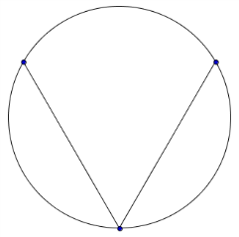
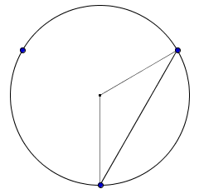
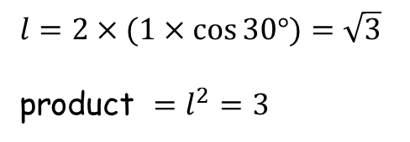





Sea Shell Product
3
$$\frac{360}{3}=120°$$
$$1$$
$$l$$
$l=2×(1×\cos{30°})=\sqrt{3}$
product $=l^{2}=3$
$$1$$
$$30°$$

Slide 4
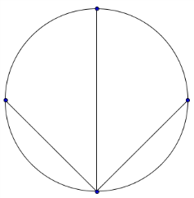
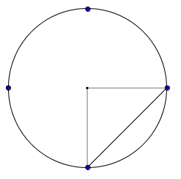
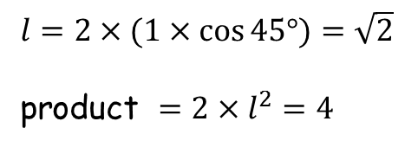




Sea Shell Product
4
$$\frac{360}{4}=90°$$
$$1$$
$l=2×(1×\cos{45°})=\sqrt{2}$
product $=2×l^{2}=4$
$$1$$
$$l$$
$$45°$$

Slide 5
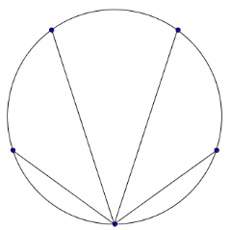
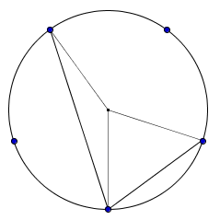
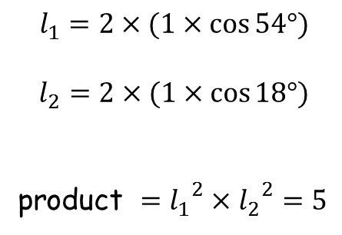






Sea Shell Product
5
$$144°$$
$$\frac{360}{5}=72°$$
$$l_{1}=2×(1×\cos{54°})$$
$$l_{2}=2×(1×\cos{18°})$$
product $={l_{1}}^{2}×{l_{2}}^{2}=5$
$$l_{2}$$
$$18°$$
$$l_{1}$$
$$54°$$

Slide 6
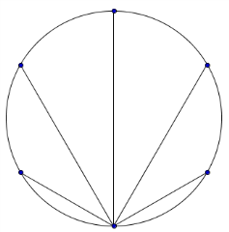
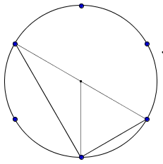
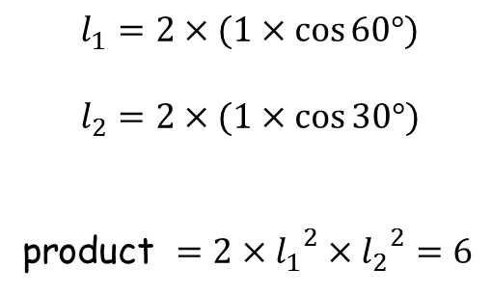






Sea Shell Product
6
$$120°$$
$$\frac{360}{6}=60°$$
$$l_{1}=2×(1×\cos{60°})$$
$$l_{2}=2×(1×\cos{30°})$$
product $=2×{l_{1}}^{2}×{l_{2}}^{2}=6$
$$l_{2}$$
$$l_{1}$$
$$30°$$
$$60°$$

Slide 7
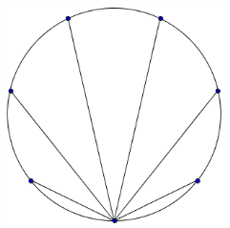
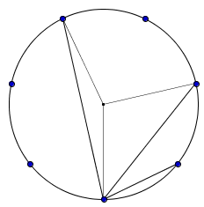
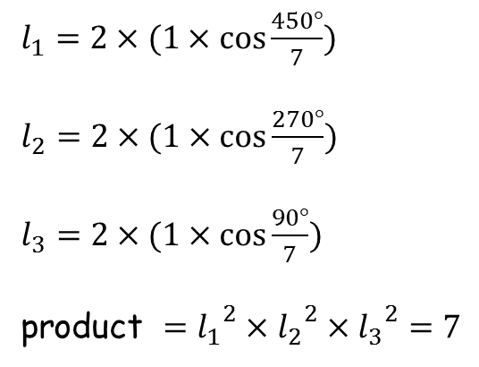
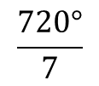




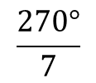

Sea Shell Product
7
$l_{1}=2×(1×\cos{\frac{450°}{7}})$
$l_{2}=2×(1×\cos{\frac{270°}{7}})$
$l_{3}=2×(1×\cos{\frac{90°}{7}})$
product $={l_{1}}^{2}×{l_{2}}^{2}×{l_{3}}^{2}=7$
$$\frac{1080°}{7}$$
$$\frac{720°}{7}$$
$$l_{3}$$
$$l_{2}$$
$$\frac{90°}{7}$$
$$l_{1}$$
$$\frac{270°}{7}$$

Slide 8
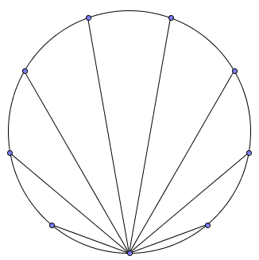
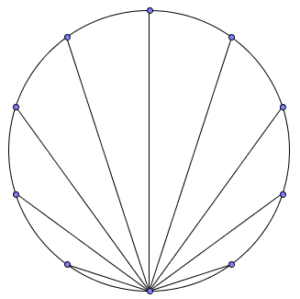

Sea Shell Product
product $=2{\left(2\cos{\frac{135}{2}}\right)}^{2}{\left(2\cos{\frac{90}{2}}\right)}^{2}{\left(2\cos{\frac{45}{2}}\right)}^{2}=8$
8
product $={\left(2\cos{70}\right)}^{2}{\left(2\cos{50}\right)}^{2}{\left(2\cos{30}\right)}^{2}{\left(2\cos{10}\right)}^{2}=9$
9
product $={2\left(2\cos{72}\right)}^{2}{\left(2\cos{54}\right)}^{2}{\left(2\cos{36}\right)}^{2}{\left(2\cos{18}\right)}^{2}=10$
10

Slide 9
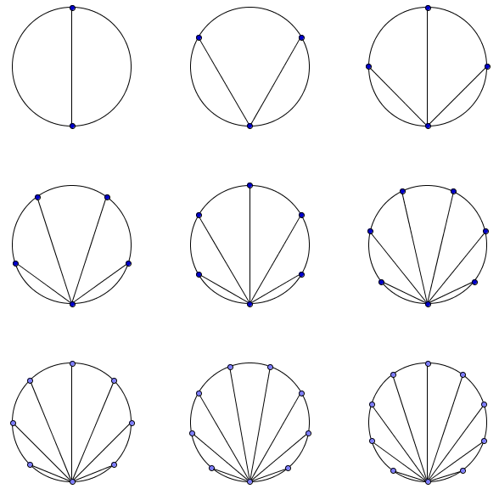
Sea Shell Product
Results
2
3
4
5
6
7
8
9
10

Slide 11
Note to Teacher
See task 84 for the proof.

Slide 12
RESOURCES

Slide 13
Sea Shell Product
SIC_44
Each circle is a unit circle (i.e. radius = 1) with dots equally spaced on the circumference.
Find the product of the lengths of the chords drawn in each circle.
Notes:
6,8

Slide 14
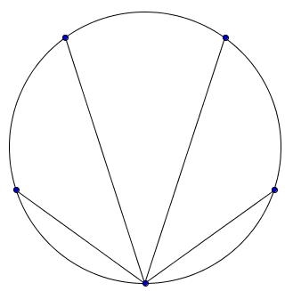
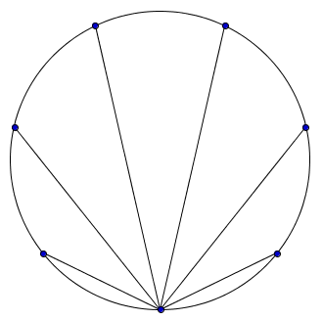
Sea Shell Product
SIC_44
Each circle is a unit circle (i.e. radius = 1) with dots equally spaced on the circumference.
Find the product of the lengths of the chords drawn in each circle.
Notes:
5,7

Slide 15
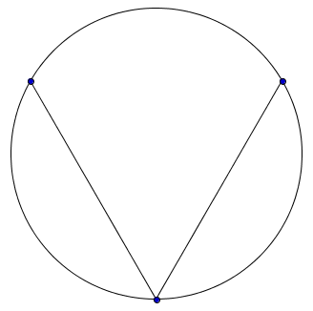
Sea Shell Product
SIC_44
Each circle is a unit circle (i.e. radius = 1) with dots equally spaced on the circumference.
Find the product of the lengths of the chords drawn in each circle.
Notes:
3,10

Slide 16
Sea Shell Product
SIC_44
Each circle is a unit circle (i.e. radius = 1) with dots equally spaced on the circumference.
Find the product of the lengths of the chords drawn in each circle.
Notes:
6,7

Slide 17
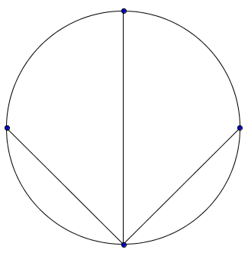
Sea Shell Product
SIC_44
Each circle is a unit circle (i.e. radius = 1) with dots equally spaced on the circumference.
Find the product of the lengths of the chords drawn in each circle.
Notes:
4,9

Slide 18
Sea Shell Product
SIC_44
Each circle is a unit circle (i.e. radius = 1) with dots equally spaced on the circumference.
Find the product of the lengths of the chords drawn in each circle.
Notes:
5,8

Slide 20
